Slide 1
Lesson 7.2: Complex SQL
CSC430/530 – DATABASE MANAGEMENT SYSTEMS

Slide 2
OUTLINE
Multisets & set operations.
Pattern matching & additional operators.
Three-valued logic.
Nested queries.
Exists, explicit sets & renaming.
Joined tables.
Aggregate functions.
Group by & Having.

Slide 3
MULTISETS, SETS & SET OPERATIONS
SQL treats tables as multisets.
Duplicated tuples can appear in the result of a query.
DISTINCT is used in SELECT clause to eliminate duplicates in the query result
For example:
SELECT Essn
FROM dependent
SELECT DISTINCT Essn
FROM dependent
DEPENDENT
Essn
123456789
333445555
987654321
Essn | Dependent_name | Sex | Bdate | Relationship
123456789 | Alice | F | 1988-12-30 | Daughter
123456789 | Elizabeth | F | 1967-05-05 | Spouse
123456789 | Michael | M | 1988-01-04 | Son
333445555 | Alice | F | 1986-04-05 | Daughter
333445555 | Joy | F | 1958-05-03 | Spouse
333445555 | Theodore | M | 1983-10-25 | Son
987654321 | Abner | M | 1942-02-28 | Spouse
Essn
123456789
123456789
123456789
333445555
333445555
333445555
987654321

Slide 4
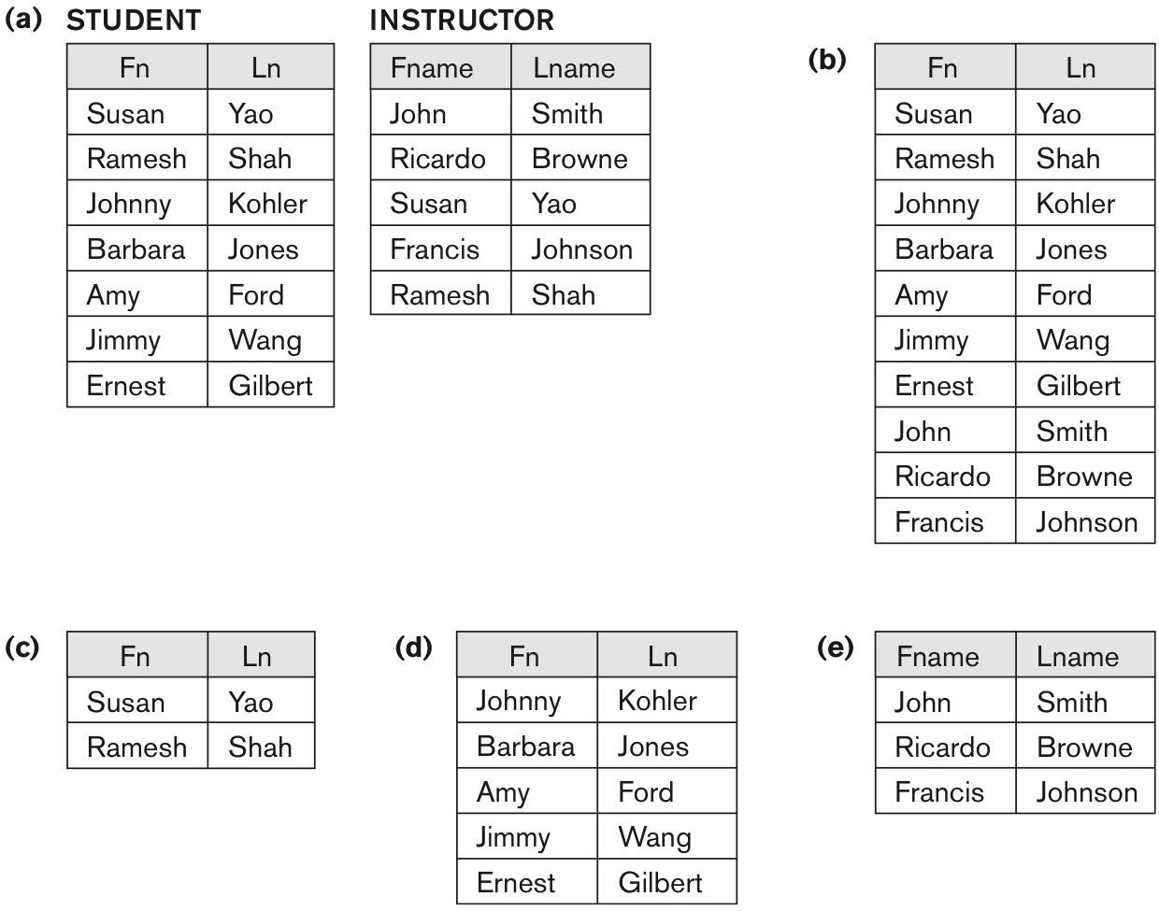
MULTISETS, SETS & SET OPERATIONS
SQL supports set operation commands.
Duplicates are eliminated in the results of set operation queries.
UNION, INTERSECT, EXCEPT (set difference).
SELECT * FROM student
UNION
SELECT * FROM instructor;
SELECT * FROM student
EXCEPT
SELECT * FROM instructor;
SELECT * FROM student
INTERSECT
SELECT * FROM instructor;

Slide 5
MULTISETS, SETS & SET OPERATIONS
Adding ALL to set operations turn them into multiset operations.
Duplicates are not eliminated.
UNION ALL, INTERSECT ALL, EXCEPT ALL.
SELECT * FROM student
UNION ALL
SELECT * FROM instructor;
SELECT * FROM student
UNION
SELECT * FROM instructor;

Slide 6
MULTISETS, SETS & SET OPERATIONS
Query 1:
Retrieve the salary of every employee;
Retrieve all distinct salary values.
Query 2:
Make a list of all project numbers for projects that involve an employee whose last name is ‘Smith’, either as a worker or as a manager of the department that controls the project.

Slide 7
MULTISETS, SETS & SET OPERATIONS
Query 1:
Retrieve the salary of every employee;
SELECT Salary FROM EMPLOYEE;
Retrieve all distinct salary values.
SELECT DISTINCT Salary FROM EMPLOYEE;
Query 2:
Make a list of all project numbers for projects that involve an employee whose last name is ‘Smith’, either as a worker or as a manager of the department that controls the project.
(SELECT W.Pno FROM WORKS_ON W, EMPLOYEE E
WHERE W.Essn = E.Ssn AND E.Lname = 'Smith')
UNION
(SELECT P.Pnumber FROM PROJECT P, DEPARTMENT D, EMPLOYEE E
WHERE P.Dnum = D.Dnumber AND D.Mgr_ssn = E.Ssn AND E.Lname = 'Smith');

Slide 8
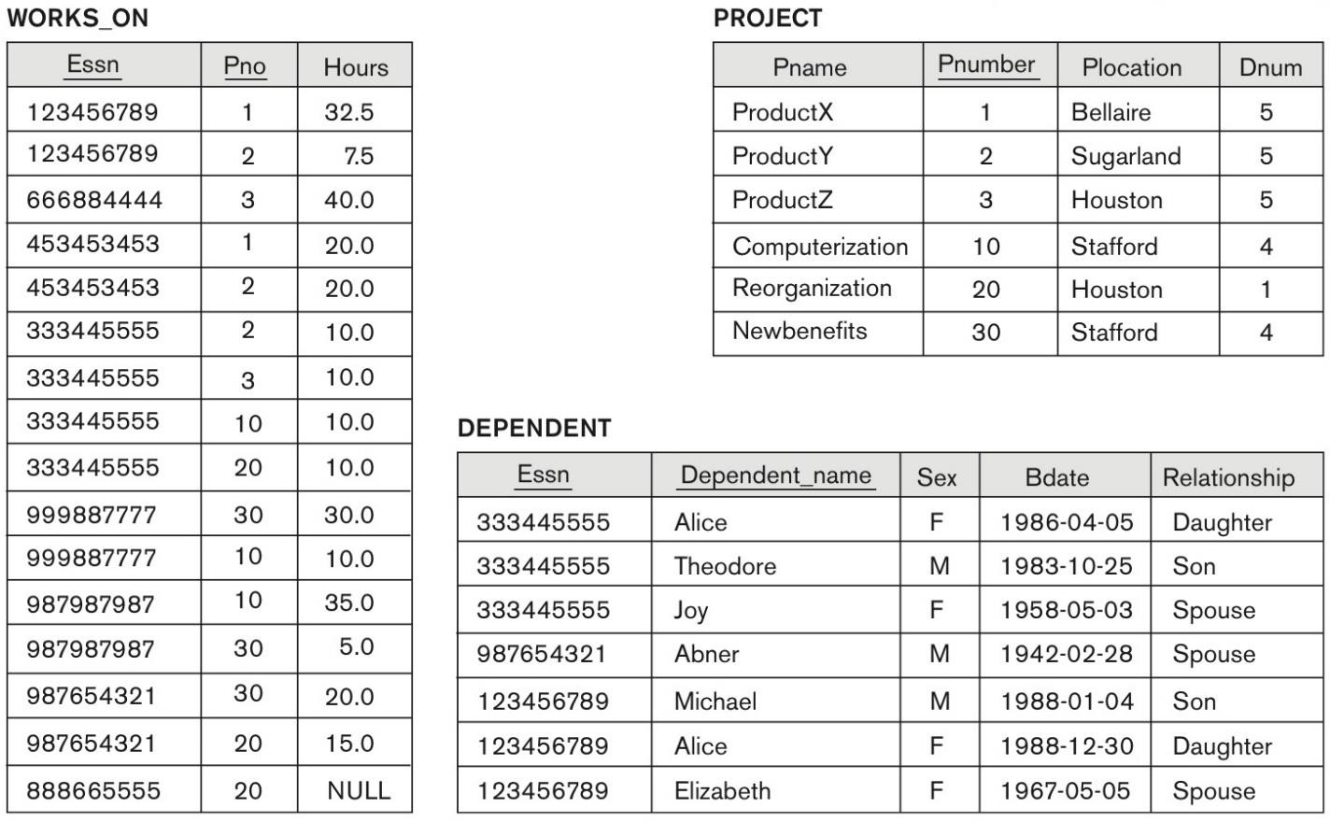
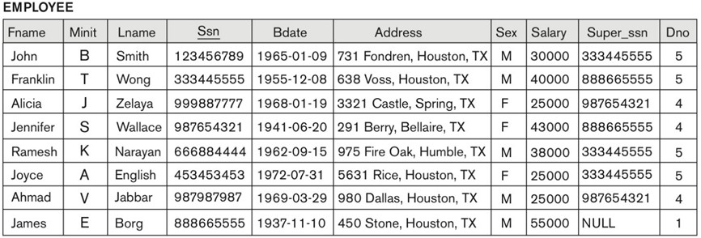
PATTERN MATCHING & ADDITIONAL OPERATORS
LIKE is used for substring pattern matching.
“_” replaces a single character, “%” replaces an arbitrary number of characters.
Pname | Pnumber
ProductX | 1
ProductY | 2
ProductZ | 3
SELECT Pname, Pnumber
FROM project
WHERE Pname LIKE "Product_"
Fname | Ssn
John | 123456789
Jennifer | 987654321
Joyce | 453453453
James | 888665555
SELECT Fname, Ssn
FROM employee
WHERE Fname LIKE "J%"

Slide 9
PATTERN MATCHING & ADDITIONAL OPERATORS
Query 3.1:
Retrieve all employees whose address is in Houston, Texas.
Query 3.2:
Find all employees who were born during the 1970s.

Slide 10
PATTERN MATCHING & ADDITIONAL OPERATORS
Query 3.1:
Retrieve all employees whose address is in Houston, Texas.
SELECT Fname, Lname
FROM EMPLOYEE
WHERE Address LIKE '%Houston, TX%';
Query 3.2:
Find all employees who were born during the 1970s.
SELECT Fname, Lname
FROM EMPLOYEE
WHERE Bdate LIKE '197_______';
/* 197x-xx-xx */

Slide 11
PATTERN MATCHING & ADDITIONAL OPERATORS
Additional operators can be used in a query.
Arithmetic operators + - * /
BETWEEN operator (equivalent to <= AND >=).
ORDER BY is used to order tuples in a query result.
DESC orders in descending order (from high to low)
ASC orders in ascending order (from low to high)
SELECT Dependent_name, Bdate
FROM dependent
WHERE bdate BETWEEN '1980-01-01' AND '1990-01-01'
ORDER BY Dependent_name ASC;
Dependent_name | Bdate
Alice | 1988-12-30
Alice | 1986-04-05
Michael | 1988-01-04
Theodore | 1983-10-25
- same as -
SELECT Dependent_name, Bdate
FROM dependent
WHERE bdate >= '1980-01-01' AND bdate <= '1990-01-01'
ORDER BY Dependent_name ASC;

Slide 12
PATTERN MATCHING & ADDITIONAL OPERATORS
Dependent_name | Bdate
Alice | 1988-12-30
Alice | 1986-04-05
Michael | 1988-01-04
Theodore | 1983-10-25
SELECT Dependent_name, Bdate
FROM dependent
WHERE bdate BETWEEN '1980-01-01' AND '1990-01-01'
ORDER BY Dependent_name ASC;
Dependent_name | Bdate
Theodore | 1983-10-25
Michael | 1988-01-04
Alice | 1986-04-05
Alice | 1988-12-30
SELECT Dependent_name, Bdate
FROM dependent
WHERE bdate BETWEEN '1980-01-01' AND '1990-01-01'
ORDER BY Dependent_name DESC, Bdate ASC;

Slide 13
PATTERN MATCHING & ADDITIONAL OPERATORS
Query 4:
Show the resulting salaries if every employee working on the ‘Product’ project is given a 10% raise.
Query 5:
Retrieve all employees in department 5 whose salary is between $30,000 and $40,000.
Query 6:
Retrieve a list of employees and the projects they are working on, ordered by department and, within each department, ordered alphabetically by last name, then first name.

Slide 14
PATTERN MATCHING & ADDITIONAL OPERATORS
Query 4:
Show the resulting salaries if every employee working on the ‘Product’ project is given a 10% raise.
SELECT E.Fname, E.Lname, 1.1 * E.Salary AS Increased_sal
FROM EMPLOYEE AS E, WORKS_ON AS W, PROJECT AS P
WHERE E.Ssn=W.Essn AND W.Pno=P.Pnumber AND P.Pname='ProductX';
Query 5:
Retrieve all employees in department 5 whose salary is between $30,000 and $40,000.
SELECT * FROM EMPLOYEE
WHERE (Salary BETWEEN 30000 AND 40000) AND Dno = 5;
Query 6:
Retrieve a list of employees and the projects they are working on, ordered by department and, within each department, ordered alphabetically by last name, then first name.
SELECT D.Dname, E.Lname, E.Fname, P.Pname
FROM DEPARTMENT AS D, EMPLOYEE AS E, WORKS_ON AS W, PROJECT AS P
WHERE D.Dnumber=E.Dno AND E.Ssn=W.Essn AND W.Pno=P.Pnumber
ORDER BY D.Dname, E.Lname, E.Fname;

Slide 15
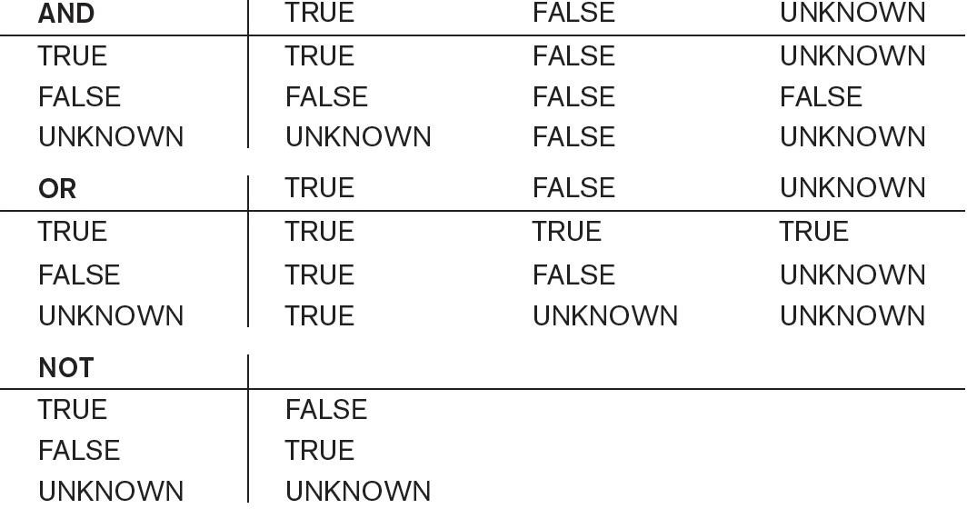
THREE-VALUED LOGIC
NULL is used in SQL to represent missing values.
Unknown, unavailable, or not applicable.
When comparing attributes with NULL value, the result is considered to be UNKNOWN
Could be TRUE or FALSE.
SQL uses three-valued logic: TRUE, FALSE, UNKNOWN.
Only combinations of tuples that evaluate to TRUE in
WHERE clause condition are selected (not FALSE and not UNKNOWN)

Slide 16
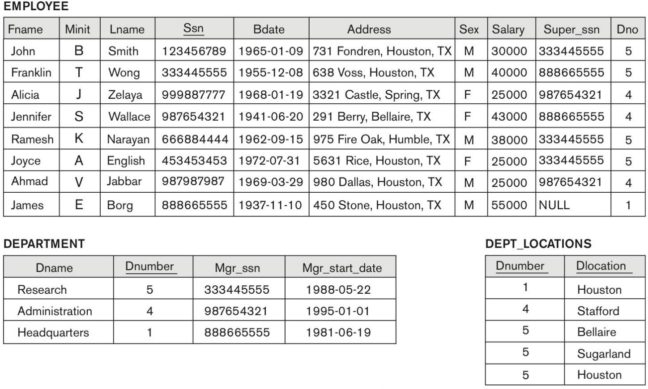
THREE-VALUED LOGIC
IS & IS NOT are used to check if an attribute value is (or is not) equal to NULL.
SELECT Fname, Lname
FROM employee
WHERE super_ssn IS NULL;
Fname | Lname
James | Borg

Slide 17
THREE-VALUED LOGIC
Query 7:
Retrieve the names of all employees who have supervisors.

Slide 18
THREE-VALUED LOGIC
Query 7:
Retrieve the names of all employees who have supervisors.
SELECT Fname, Lname
FROM employee
WHERE super_ssn IS NOT NULL;

Slide 19
NESTED QUERIES
Queries can be nested inside FROM or WHERE clauses of other queries.
Inner (nested) query, outer query.
SELECT emp_names.Fname
FROM (SELECT Fname, Lname FROM employee) AS emp_names;
SELECT Dlocation
FROM dept_locations
WHERE Dnumber IN (
SELECT Dnumber
FROM department
WHERE Dname = "Research"
);
Fname
Alice
Alice
Michael
Theodore
Dlocation
Bellaire
Houston
Sugarland

Slide 20
NESTED QUERIES
Correlated nested queries – condition in the WHERE clause of inner query references some
attribute of a relation declared in the outer query.
Inner (nested) query is evaluated once for each tuple (or combination of tuples) in the outer query.
Aliasing is recommended to use in nested queries.

Slide 21
NESTED QUERIES
Comparison operators can be used with ANY or ALL quantifiers.
SELECT Fname, Lname
FROM employee
WHERE ssn = ANY (
SELECT Essn
FROM dependent
WHERE Bdate > '1960-01-01'
);
Fname | Lname
John | Smith
Franklin | Wong

Slide 22
NESTED QUERIES
Comparison operators can be used with ANY or ALL quantifiers.
SELECT Fname, Lname
FROM employee
WHERE dno = 5 AND
salary >= ALL (
SELECT salary
FROM employee
WHERE dno = 5
);
Fname | Lname
Franklin | Wong
SELECT Fname, Lname
FROM employee
WHERE dno = 4 AND
salary <= ALL (
SELECT salary
FROM employee
WHERE dno = 4
);
Fname | Lname
Ahmad | Jabbar
Alicia | Zelaya

Slide 23
NESTED QUERIES
Query 8:
Make a list of all project numbers for projects that involve an employee whose last name is ‘Smith’, either as a worker or as a manager of the department that controls the project.

Slide 24
NESTED QUERIES
Query 8:
Make a list of all project numbers for projects that involve an employee whose last name is ‘Smith’, either as a worker or as a manager of the department that controls the project.
SELECT Pnumber
FROM PROJECT
WHERE Pnumber IN (
SELECT W.Pno
FROM WORKS_ON W, EMPLOYEE E
WHERE W.Essn = E.Ssn AND E.Lname = 'Smith'
)
OR Pnumber IN (
SELECT P.Pnumber
FROM PROJECT P, DEPARTMENT D, EMPLOYEE E
WHERE P.Dnum = D.Dnumber AND D.Mgr_ssn = E.Ssn AND E.Lname = 'Smith'
);

Slide 25
NESTED QUERIES
Query 9:
Retrieve the name of each employee who has a dependent with the same first name and is the same sex as the employee.

Slide 26
NESTED QUERIES
Query 9:
Retrieve the name of each employee who has a dependent with the same first name and is the same sex as the employee.
SELECT E.Fname, E.Lname
FROM EMPLOYEE AS E
WHERE E.Ssn IN (
SELECT D.Essn
FROM DEPENDENT AS D
WHERE E.Fname = D.Dependent_name AND E.Sex = D.Sex
);
/* In general, a query written with nested select-from-where blocks and using the = or IN comparison operators can always be expressed as a single block query.*/
SELECT E.Fname, E.Lname
FROM EMPLOYEE AS E, DEPENDENT AS D
WHERE E.Ssn = D.Essn AND E.Sex = D.Sex AND
E.Fname = D.Dependent_name;

Slide 27
NESTED QUERIES
Query 10:
List the names of employees whose salary is greater than the salary of all the employees in department 5.

Slide 28
NESTED QUERIES
Query 10:
List the names of employees whose salary is greater than the salary of all the employees in department 5.
SELECT Lname, Fname, Salary
FROM EMPLOYEE
WHERE Salary > ALL (
SELECT Salary
FROM EMPLOYEE
WHERE Dno = 5
);

Slide 29
EXISTS
EXISTS is a Boolean function that is used in WHERE clause.
Typically used in conjunction with a correlated nested query.
EXISTS checks whether the result of a nested query is empty (contains no tuples) or not.
TRUE if the nested query result contains at least one tuple.
FALSE if the nested query result contains no tuples.
Fname | Lname
Franklin | Wong
Jennifer | Wallace
John | Smith
Joyce | English
Ramesh | Narayan
SELECT Fname, Lname
FROM employee AS e
WHERE EXISTS (
SELECT *
FROM department AS d
WHERE mgr_start_date < '1990-01-01'
AND d.mgr_ssn = e.super_ssn
);

Slide 30
EXISTS
We can achieve the same result in multiple ways
Fname | Lname
Franklin | Wong
Jennifer | Wallace
John | Smith
Joyce | English
Ramesh | Narayan
SELECT Fname, Lname
FROM employee AS e
WHERE EXISTS (
SELECT *
FROM department AS d
WHERE mgr_start_date < '1990-01-01'
AND d.mgr_ssn = e.super_ssn
);
SELECT Fname, Lname
FROM employee
WHERE super_ssn = ANY (
SELECT mgr_ssn
FROM department
WHERE mgr_start_date < '1990-01-01'
);

Slide 31
EXISTS
Can use NOT EXISTS to test the opposite (i.e. returns true if result is no tuples).
SELECT fname, lname
FROM employee AS e
WHERE NOT EXISTS (
SELECT *
FROM department AS d
WHERE mgr_start_date < '1990-01-01'
AND d.mgr_ssn = e.super_ssn
);
Fname | Lname
James | Borg
Ahmad | Jabbar
Alicia | Zelaya

Slide 32
EXISTS
SELECT fname, lname
FROM employee AS e
WHERE NOT EXISTS (
SELECT *
FROM department AS d
WHERE mgr_start_date < '1990-01-01'
AND d.mgr_ssn = e.super_ssn
);
Fname | Lname
James | Borg
Ahmad | Jabbar
Alicia | Zelaya
SELECT fname, lname
FROM employee AS e
WHERE NOT EXISTS (
SELECT *
FROM department AS d
WHERE mgr_start_date < '1990-01-01'
AND d.mgr_ssn = e.super_ssn
)
AND e.super_ssn IS NOT NULL;
Fname | Lname
Ahmad | Jabbar
Alicia | Zelaya

Slide 33
EXISTS
Query 11:
Alternative to Query 9 (i.e. Retrieve the name of each employee who has a dependent with the same first name and is the same sex as the employee), but with EXISTS.
Query 12:
Retrieve the names of employees who have no dependents.

Slide 34
EXISTS
Query 11:
Alternative to Query 9 (i.e. Retrieve the name of each employee who has a dependent with the same first name and is the same sex as the employee), but with EXISTS.
SELECT E.Fname, E.Lname
FROM EMPLOYEE AS E
WHERE EXISTS (
SELECT *
FROM DEPENDENT AS D
WHERE E.Ssn=D.Essn AND E.Sex=D.Sex AND E.Fname=D.Dependent_name
);
Query 12:
Retrieve the names of employees who have no dependents.
SELECT Fname, Lname
FROM EMPLOYEE E
WHERE NOT EXISTS (
SELECT *
FROM DEPENDENT D
WHERE E.Ssn = D.Essn
);

Slide 35
EXISTS
Query 13:
List the names of managers who have at least one dependent.

Slide 36
EXISTS
Query 13:
List the names of managers who have at least one dependent.
SELECT Fname, Lname
FROM EMPLOYEE E
WHERE EXISTS (
SELECT *
FROM DEPARTMENT DEP
WHERE E.Ssn = DEP.Mgr_ssn
)
AND EXISTS (
SELECT *
FROM DEPENDENT D
WHERE E.Ssn = D.Essn
);

Slide 37
EXPLICIT SETS & RENAMING
Use IN to specify explicit sets of values for the WHERE clause.
Enclose values in parentheses.
AS command is used to rename (alias) relations or attributes in appropriate part of a query.
SELECT Pname AS Project_Name,
Dnum AS Dept_Num
FROM project
WHERE Dnum IN (1, 4);
Project_Name | Dept_Num
Reorganization | 1
Computerization | 4
Newbenefits | 4

Slide 38
EXPLICIT SETS & RENAMING
You can not use an attribute alias from your select clause in your where clause.
This is not supported since (when the query is being compiled and executed) the select alias takes effect after the where clause has been applied.
To accomplish this, use HAVING instead of WHERE (we will see this command again in a later slide)
Aliasing happens before HAVING is evaluated, so it knows about the aliases from the select clause
SELECT Pname AS Project_Name,
Dnum AS Dept_Num
FROM project
WHERE Dept_Num IN (1, 4);
SELECT Pname AS Project_Name,
Dnum AS Dept_Num
FROM project
HAVING Dept_Num IN (1, 4);

Slide 39
EXPLICIT SETS & RENAMING
Query 14:
Retrieve Social Security numbers of all employees who work on project numbers 1, 2, or 3.
Query 15:
Retrieve last name of each employee and his/her supervisor while renaming the resulting attribute names as Employee_name and Supervisor_name.

Slide 40
EXPLICIT SETS & RENAMING
Query 14:
Retrieve Social Security numbers of all employees who work on project numbers 1, 2, or 3.
SELECT DISTINCT Essn
FROM WORKS_ON
WHERE Pno IN (1, 2, 3);
Query 15:
Retrieve last name of each employee and his/her supervisor while renaming the resulting attribute names as Employee_name and Supervisor_name.
SELECT E.Lname AS Employee_name, S.Lname AS Supervisor_name
FROM EMPLOYEE AS E, EMPLOYEE AS S
WHERE E.Super_ssn = S.Ssn;

Slide 41
JOINED TABLES
Tables can be joined explicitly in FROM clause.
JOIN … ON.
SELECT p.pname, p.pnumber, p.plocation, d.dname
FROM ( project p JOIN department d ON p.dnum = d.dnumber );
NATURAL JOIN.
SELECT p.pname, p.pnumber, p.plocation, d.dname
FROM ( project p NATURAL JOIN (
SELECT dname, dnumber AS dnum
FROM department
) AS d
);

Slide 42
JOINED TABLES
Query 16:
Retrieve the name and address of every employee who works for the ‘Research’ department.
Query 17:
Rename the department number attribute of DEPARTMENT relation and then use a NATURAL JOIN with EMPLOYEE relation.

Slide 43
JOINED TABLES
Query 16:
Retrieve the name and address of every employee who works for the ‘Research’ department.
SELECT E.Fname, E.Lname, E.Address
FROM (
EMPLOYEE E JOIN DEPARTMENT D ON E.Dno = D.Dnumber
)
WHERE D.Dname = 'Research';
Query 17:
Rename the department number attribute of DEPARTMENT relation and then use a NATURAL JOIN with EMPLOYEE relation.
SELECT E.Fname, E.Lname, E.Address
FROM (
EMPLOYEE E NATURAL JOIN (
SELECT D.Dname, D.Dnumber AS Dno, D.Mgr_ssn, D.Mgr_start_date
FROM DEPARTMENT D
) AS DEPT
)
WHERE DEPT.Dname = 'Research';

Slide 44
JOINED TABLES
SELECT E.Fname, E.Lname, E.Address
FROM ( employee E JOIN department D ON E.Dno = D.Dnumber )
WHERE D.Dname = 'Research';
SELECT E.Fname, E.Lname, E.Address
FROM (
employee E NATURAL JOIN (
SELECT D.Dname, D.Dnumber AS Dno, D.Mgr_ssn, D.Mgr_start_date
FROM department D
) AS DEPT
)
WHERE DEPT.Dname = 'Research';
SELECT E.Fname, E.Lname, E.Address
FROM employee e, department d
WHERE e.dno = d.dnumber AND d.dname = 'Research';

Slide 45
JOINED TABLES
Multiway JOIN … ON.
FROM (
(employee e JOIN project p ON e.dno = p.dnum)
JOIN works_on w ON p.pnumber = w.pno
)

Slide 46
JOINED TABLES
Query 18:
For every project located in ‘Stafford’, list the project number, the controlling department number, and the department manager’s last name, address, and birth date.

Slide 47
JOINED TABLES
Query 18:
For every project located in ‘Stafford’, list the project number, the controlling department number, and the department manager’s last name, address, and birth date.
SELECT P.Pnumber, D.Dnumber, E.Lname, E.Address, E.Bdate
FROM (
(PROJECT P JOIN DEPARTMENT D ON P.Dnum = D.Dnumber)
JOIN EMPLOYEE E ON D.Mgr_ssn = E.Ssn
)
WHERE P.Plocation = 'Stafford';

Slide 48
AGGREGATE FUNCTIONS
Aggregate functions are used to summarize information from multiple tuples into a single-tuple
summary.
Normally used in SELECT or HAVING clause.
COUNT, SUM, MAX, MIN, AVG.
COUNT function returns the number of tuples or values as specified in a query.
SUM, MIN, MAX, and AVG are used with attributes.
NULL values are discarded when aggregate functions are applied to a particular attribute.
Exception is COUNT(*) since it counts tuples instead of values.

Slide 49
AGGREGATE FUNCTIONS
SELECT COUNT(essn),
SUM(hours)
FROM works_on
WHERE pno = 1;
SELECT dname, mgr_start_date
FROM department
WHERE mgr_start_date = (
SELECT MIN(mgr_start_date)
FROM department
);
SELECT dname, mgr_start_date
FROM department
WHERE mgr_start_date = (
SELECT MAX(mgr_start_date)
FROM department
);
COUNT(essn) | SUM(hours)
2 | 52.5
dname | mgr_start_date
Headquarters | 1981-06-19
dname | mgr_start_date
Administration | 1995-01-01

Slide 50
AGGREGATE FUNCTIONS
Query 19.1:
Find the sum of the salaries of all employees, the maximum salary, the minimum salary, and the average salary without attribute renaming.
Query 19.2:
Find the sum of the salaries of all employees, the maximum salary, the minimum salary, and the average salary with attribute renaming.

Slide 51
AGGREGATE FUNCTIONS
Query 19.1:
Find the sum of the salaries of all employees, the maximum salary, the minimum salary, and the average salary without attribute renaming.
SELECT SUM(Salary),
MAX(Salary),
MIN(Salary),
AVG(Salary)
FROM EMPLOYEE;
Query 19.2:
Find the sum of the salaries of all employees, the maximum salary, the minimum salary, and the average salary with attribute renaming.
SELECT SUM(Salary) AS Total_Salary,
MAX(Salary) AS Highest_Salary,
MIN(Salary) AS Lowest_Salary,
AVG(Salary) AS Average_Salary
FROM EMPLOYEE;

Slide 52
AGGREGATE FUNCTIONS
Query 20:
Find the sum of the salaries of all employees of the ‘Research’ department, as well as the maximum salary, the minimum salary, and the average salary in this department.
Query 21:
Count the number of distinct salary values in the database.

Slide 53
AGGREGATE FUNCTIONS
Query 20:
Find the sum of the salaries of all employees of the ‘Research’ department, as well as the maximum salary, the minimum salary, and the average salary in this department.
SELECT SUM(E.Salary),
MAX(E.Salary),
MIN(E.Salary),
AVG(E.Salary)
FROM (
EMPLOYEE E JOIN DEPARTMENT D ON E.Dno = D.Dnumber
)
WHERE D.Dname = 'Research';
Query 21:
Count the number of distinct salary values in the database.
SELECT COUNT(DISTINCT Salary)
FROM EMPLOYEE;

Slide 54
AGGREGATE FUNCTIONS
Query 22:
Retrieve the names of all employees who have two or more dependents.

Slide 55
AGGREGATE FUNCTIONS
Query 22:
Retrieve the names of all employees who have two or more dependents.
SELECT E.Lname, E.Fname
FROM EMPLOYEE E
WHERE (
SELECT COUNT(*)
FROM DEPENDENT D
WHERE E.Ssn = D.Essn
) >= 2;

Slide 56
GROUP BY & HAVING
GROUP BY is used to partition relation into non-overlapping subsets.
Each partition (group) consists of the tuples that have same value for some grouping attribute(s).
GROUP BY specifies the grouping attribute(s), which also appear(s) in SELECT clause.
GROUP BY is applied after joining tables if used in conjunction with join condition.
Pno | SUM(hours)
1 | 52.5
2 | 37.5
3 | 50.0
10 | 55.0
20 | 25.0
30 | 55.0
SELECT Pno, SUM(hours)
FROM works_on
GROUP BY Pno;

Slide 57
GROUP BY & HAVING
SELECT dno,
salary,
COUNT(*) AS emp_count
FROM employee
GROUP BY dno, salary;
dno | salary | emp_count
1 | 55000.00 | 1
4 | 25000.00 | 2
4 | 43000.00 | 1
5 | 25000.00 | 1
5 | 30000.00 | 1
5 | 38000.00 | 1
5 | 40000.00 | 1
SELECT dno,
salary,
COUNT(*) AS emp_count
FROM employee
GROUP BY dno;
dno | salary | emp_count
1 | 55000.00 | 1
4 | 43000.00 | 3
5 | 30000.00 | 4

Slide 58
GROUP BY & HAVING
Query 23:
For each department, retrieve the department number, the number of employees in the department, and their average salary.
Query 24:
For each project, retrieve the project number, the project name, and the number of employees who work on that project.

Slide 59
GROUP BY & HAVING
Query 23:
For each department, retrieve the department number, the number of employees in the department, and their average salary.
SELECT Dno, COUNT(*), AVG(Salary)
FROM EMPLOYEE
GROUP BY Dno;
Query 24:
For each project, retrieve the project number, the project name, and the number of employees who work on that project.
SELECT P.Pnumber, P.Pname, COUNT(*)
FROM PROJECT P, WORKS_ON W
WHERE P.Pnumber = W.Pno
GROUP BY P.Pnumber, P.Pname;

Slide 60
GROUP BY & HAVING
HAVING is used with GROUP BY to retrieve only those groups that satisfy certain condition.
HAVING is applied after the condition is evaluated in WHERE clause.
WHERE clause is executed first, to select individual tuples or joined tuples;
HAVING clause is applied later, to select individual groups of tuples.
SELECT dno, salary, COUNT(*) AS emp_count
FROM employee
GROUP BY dno, salary;
SELECT dno, salary, COUNT(*) AS emp_count
FROM employee
GROUP BY dno, salary
HAVING salary > 30000;
dno | salary | emp_count
1 | 55000.00 | 1
4 | 25000.00 | 2
4 | 43000.00 | 1
5 | 25000.00 | 1
5 | 30000.00 | 1
5 | 38000.00 | 1
5 | 40000.00 | 1
dno | salary | emp_count
1 | 55000.00 | 1
4 | 43000.00 | 1
5 | 38000.00 | 1
5 | 40000.00 | 1

Slide 61
GROUP BY & HAVING
Query 25:
For each project on which more than two employees work, retrieve the project number, the project name, and the number of employees who work on the project.

Slide 62
GROUP BY & HAVING
Query 25:
For each project on which more than two employees work, retrieve the project number, the project name, and the number of employees who work on the project.
SELECT P.Pnumber,
P.Pname,
COUNT(*) AS emp_count
FROM project AS P,
works_on AS W
WHERE P.Pnumber = W.Pno
GROUP BY P.Pnumber, P.Pname
HAVING emp_count > 2;

Slide 63
SUMMARY OF SQL QUERIES
General structure of retrieval SQL query.
SELECT <attribute and function list>
FROM <table list> [WHERE <condition>]
[GROUP BY <grouping attribute(s)>] [HAVING <group condition>] [ORDER BY <attribute list>];
SELECT lists the attributes or functions to be retrieved.
FROM specifies all relations (tables) needed in the query, including joined relations.
WHERE specifies the conditions for selecting the tuples from these relations, including join conditions.
GROUP BY specifies grouping attributes.
HAVING specifies a condition on the groups being selected rather than on the individual tuples.
Aggregate functions (COUNT, SUM, MIN, MAX, AVG) are used in conjunction with grouping, or applied to all the selected
tuples in a query without a GROUP BY clause.
ORDER BY specifies an order for displaying the result of a query.

